Slide 1
Year 12 home study
Mrs Withington VTCT Beauty Therapy
NAIL THEORY
Structure of the Nail
Function of the Nail
Growth of the Nail
Natural Nail Shapes
Notes:
This lesson focuses on Nail Theory:
Structure of the Nail
Function of the Nail
Growth of the Nail
Natural Nail Shapes

Slide 2
Welcome to beauty therapy
This induction task will prepare you with the essential knowledge, needed to perform a manicure service to industry standards.
Please read through the PowerPoint and make your own notes.
The last slide will give you instructions on the assignment that you will need to complete.
This will need to be carried out by using your notes from this PowerPoint and extensive research on the internet/text books.
Once you have completed the assignment it will need to be emailed to myself for marking.
You can communicate with me at any time using email or TEAMS
Good luck
jwithington@prospect.reading.sch.uk

Slide 3

EXPLORE
What do you consider to be the most important part of the nail?
INSPIRE
Understanding the basic structure, function and growth of the nail will allow you to provide your clients with safe and effective services that meet their needs.
Notes:
Explore
What do you consider to be the most important part of the nail?
Inspire
Understanding the basic structure, function and growth of the nail will allow you to provide your clients with safe and effective services that meet their needs.

Slide 4
What will I achieve?
Identify the structure of the nail
Describe the function of the nail
Explain the factors that influence nail growth
Describe various natural nail shapes
Notes:
Following this lesson, you’ll be able to:
Identify the structure of the nail
Describe the function of the nail
Explain the factors that influence nail growth
Describe various natural nail shapes

Slide 5
NAIL THEORY
The study of the structure and growth of the nails is called onychology.
Notes:
Like the hair, the nail is an appendage of the skin.
The technical name for the nail is onyx.

Slide 6
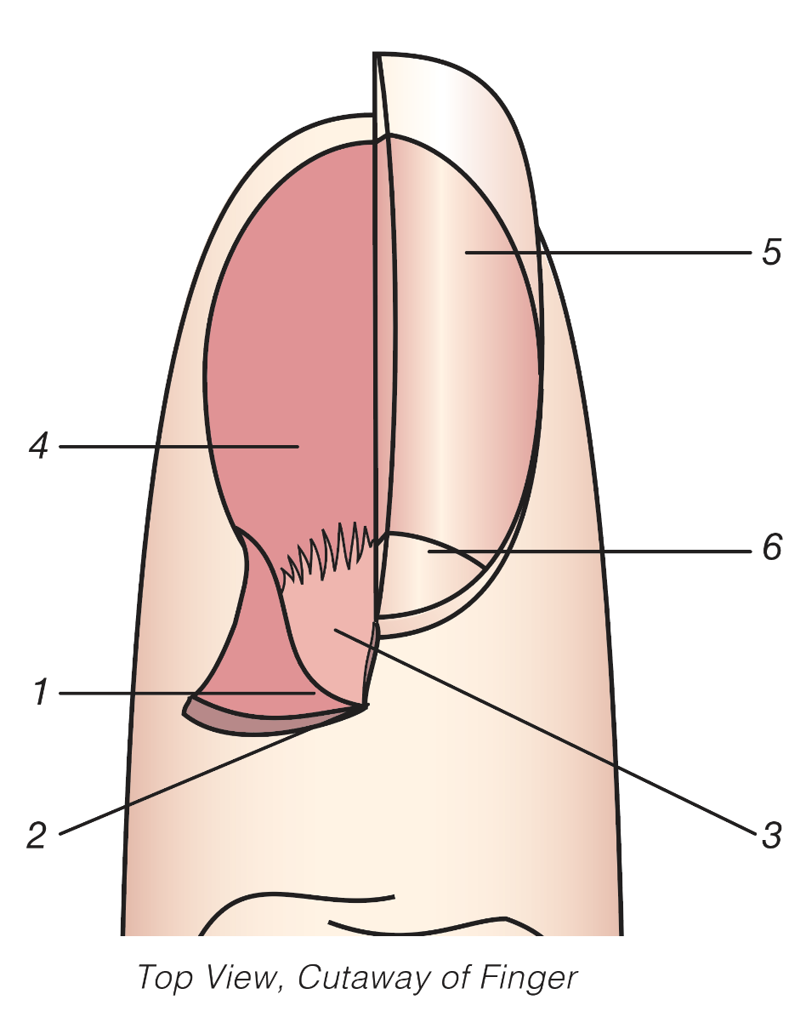
STRUCTURE OF THE NAIL
1. Mantle
2. Nail Matrix
3. Nail Root
4. Nail Bed
5. Nail Plate
6. Lunula
Notes:
Mantle – Pocket-like; holds root and matrix
Nail matrix – Active tissue; generates cells
Nail root – Attached to matrix at base, under skin and inside mantle
Nail bed – Area on which nail body rests; nerves and blood vessels provide nourishment
Nail plate – Visible nail, root to free edge; no nerves or blood vessels
Lunula – Half-moon shape; visible part of the matrix

Slide 7
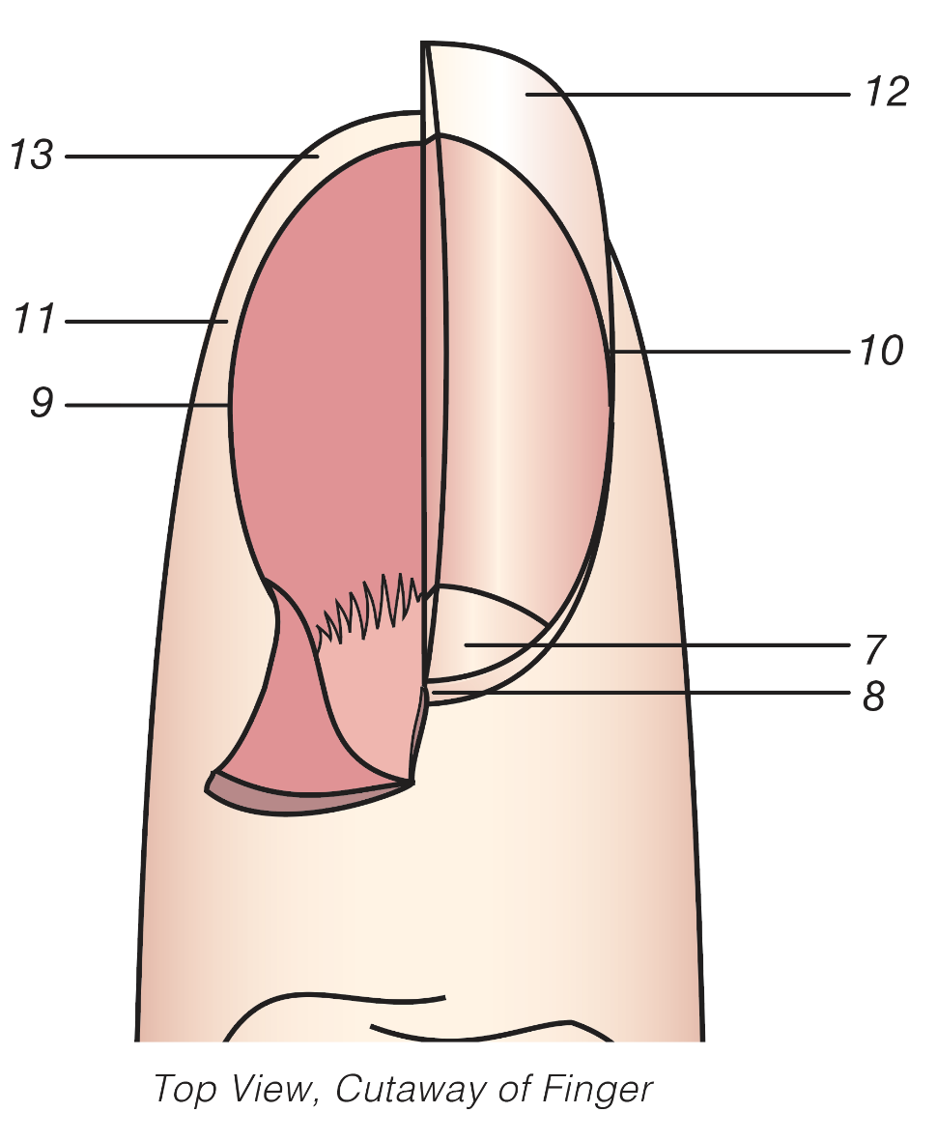
STRUCTURE OF THE NAIL
7. Eponychium
8. Cuticle
9. Nail Grooves
10. Sidewalls
11. Perionychium
12. Free Edge
13. Hyponychium
Notes:
Eponychium – Live tissue at base of nail
Cuticle – Overlapping dead tissue around nail
Nail grooves – Tracks on either side that the nail moves on as it grows
Sidewalls – Folds of skin on either side of the nail groove
Perionychium – Living tissue, overlies nail plate on sides of nail
Free edge – Part of nail that extends beyond finger or toe; protects
Hyponychium – Living tissue underneath free edge of nail

Slide 8
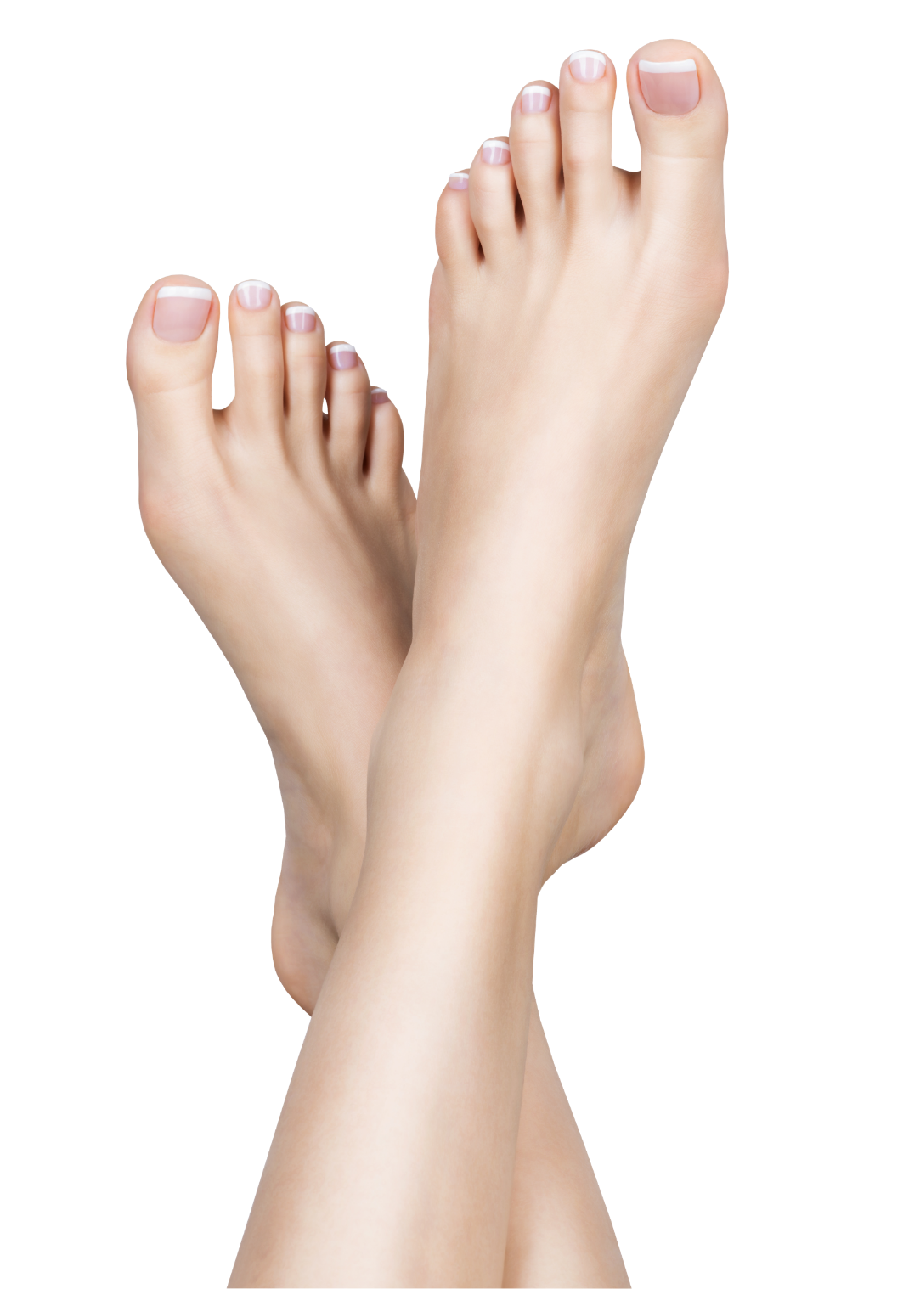
FUNCTION OF THE NAIL
Protect
Enhance
Assist
Notes:
Three main functions of the nail:
To protect nail bed and nail plate
To enhance fingertip sensitivity
To assist fingers when picking up small objects
For a healthy nail, general appearance of nail should be firm and pink in colour
Transversal (extending across) shape of nail determined by shape of underlying bone

Slide 9
GROWTH OF THE NAIL
Originates from the matrix
Cells are pushed outwards from nail root
Cells keratinise
Cells fully harden
Hardened cells form the nail plate
Notes:
Process of nail growth:
Matrix (located in mantle) contains lymph, blood vessels and nerves that create cells
Cells are pushed outwards from nail root
Cells keratinise and are fully hardened when they reach eponychium
Hardened cells form nail plate that travels in nail grooves
Thinness or thickness of nail plate determined by rate of cell production

Slide 10

GROWTH OF THE NAIL
Nail Growth Facts
Average fingernail growth rate is 0.3 cm per month for adults
Faster in summer than winter
Middle fingernail grows fastest, thumbnail slowest
Notes:
Nail growth facts:
Average fingernail growth rate is 0.3 cm per month for adults
Younger people’s nails grow faster
Faster in summer than winter
On average, 4–6 months for nail to completely replace itself
Nutrition, health and disease affect growth
Middle fingernail grows fastest, thumbnail slowest
Nails grow faster on favoured hand
Toenails grow slower than fingernails
Takes 12–18 months for nail to replace itself
Injuries can distort or discolour nail. Permanent distortion can occur if:
Nail is lost due to trauma, nail bed or matrix injured without protection of nail plate
Nail is lost through disease or infection

Slide 11
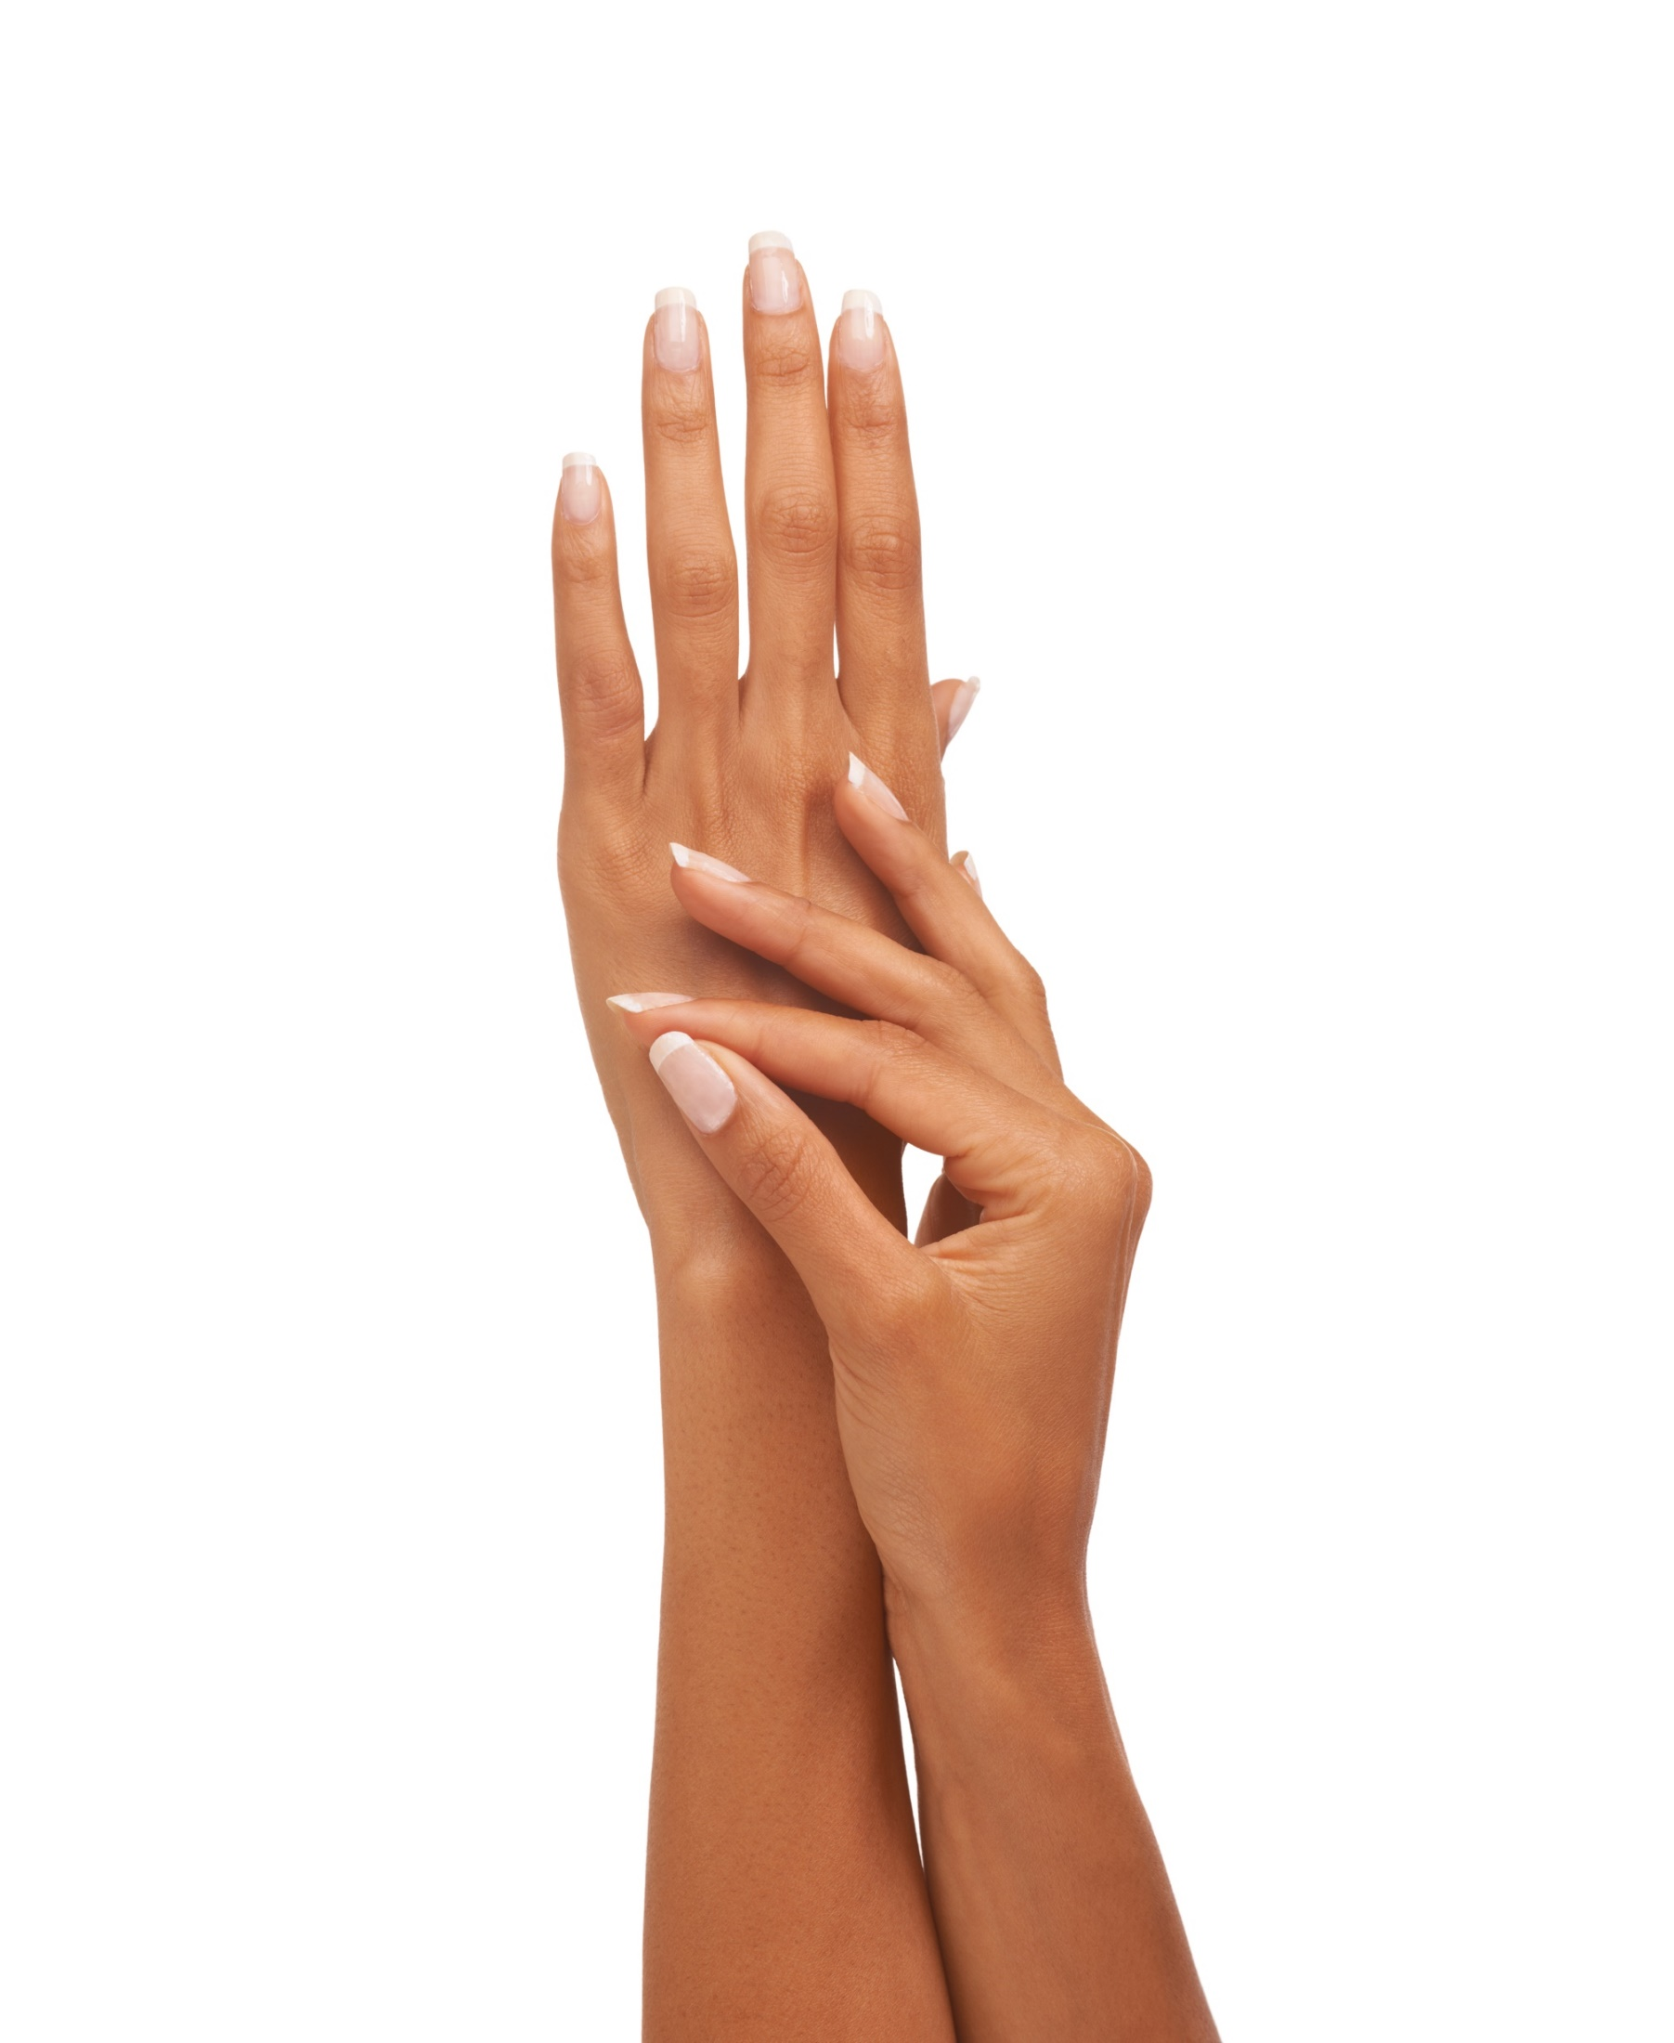
NATURAL NAIL SHAPES
Oval
Ski jump/spoon
Fan
Claw/hook
Bitten nails
Notes:
Appearance of nail shapes:
Oval – Free edge is rounded, ideal natural nail shape
Ski jump/spoon – Nail curves up and grows outwards at the free edge
Fan – Nail grows outwards at the free edge
Claw/hook – Nail grows downwards
Bitten nails – Although bitten nails aren't classified as a nail shape, they are short, torn cuticles and sidewalls

Slide 12
205^{bt}.4 NAIL THEORY REVIEW
STRUCTURE OF THE NAIL
Mantle (proximal nail fold)
Nail matrix
Nail root
Nail bed
Nail plate
Lunula

Slide 13
205^{bt}.4 NAIL THEORY REVIEW
STRUCTURE OF THE NAIL (CONT’D)
Eponychium
Cuticle
Nail grooves
Sidewalls
Perionychium
Free edge
Hyponychium
Notes:
Validate learning by celebrating what has been learned.

Slide 14
205^{bt}.4 NAIL THEORY REVIEW
FUNCTION OF THE NAIL
To provide protection for the nail bed and through the
nail plate
To enhance fingertip sensitivity
To assist fingers when picking up small objects
Notes:
Validate learning by celebrating what has been learned.

Slide 15
205^{bt}.4 NAIL THEORY REVIEW
GROWTH OF THE NAIL
The growth of the nail originates from the matrix, located in the mantle
Nails grow at 0.3 cm per month for adults
Injuries to the nail can result in shape distortions or
nail discolouration
Notes:
Validate learning by celebrating what has been learned.

Slide 16
205^{bt}.4 NAIL THEORY REVIEW
NATURAL NAIL SHAPES
Nail shapes, other than oval, that may vary treatment are:
Ski jump/spoon
Fan
Claw/hook
Bitten nails
Notes:
Validate learning by celebrating what has been learned.

Slide 17
Assignment-Mind map-Word Wall
You will use the information from the PowerPoint and your own extended research to complete the tasks set
Write a report for the institute of Beauty therapists on the study of the structure of the nails which is known as Onychology:
Assignment
Give an overview of what a manicure is using the correct terminology.
Describe the process of nail growth
Explain why salon owners should have an understanding of Health & Safety regulations and why they should be following them to include. (HSAWA)1974 (RIDDOR ) (COSHH) 2002 (PPE)
You now need to explain how the legislation links in with carrying out manicures in a salon.
A bibliography must be evident
www.hse.gov.uk
The Mind Map and Word Wall are on separate sheets

